Slide 1
NeverFail Automated System Testing
A Project by:
Anthony Ofili, Aziz Alibrahim and Paloma Samaniego

Slide 2
Problem Diagnosis

Slide 3
The Problem
Systems don’t run at optimum efficiency simply because they are not tested efficiently.
Doesn’t scale and requires one or more full-time technicians
Doesn’t record past history of results since everything is communicated via email
Can only run tests when the technician is in the office

Slide 4
Proposed Solution

Slide 5
NeverFail Solution
Automated test system that utilizes a java controller, mySQL database, client tests written in python and php to run a web based GUI.
System admin that can log in, add/edit/remove python tests, view test logs, create and run a test suite which can be saved for future use.
By allowing the creation of Test Suites it is easy for the admin to incorporate the use of our scheduling feature to run the desired test suite on the desired client at any given time increments, without any need for business process changes.

Slide 6
Building Blocks
Inputs
Java controller
mySQL database
Python tests
PHP Command In Control
Outputs
Web based GUI
Workflow: Java controller requests tests from Command Control, tests will run, and ultimately test results will be posted to a web UI for the administrator to view.

Slide 7
Benefits
Reduces Manpower
Ensures the systems in a company/institution are running efficiently.
Allows tests to be run 24/7 not just when Technician is in the office

Slide 8
Construction Details

Slide 9

System Diagram
Request Test
Java Controller
Command in Control
Report Results
Tests
Memory
Storage
Video
Networking
Integer Math Test
Floating Point Test
Prime Number Test
DB
WEB UI
Web UI - DataTable Displaying all Test details

Slide 10
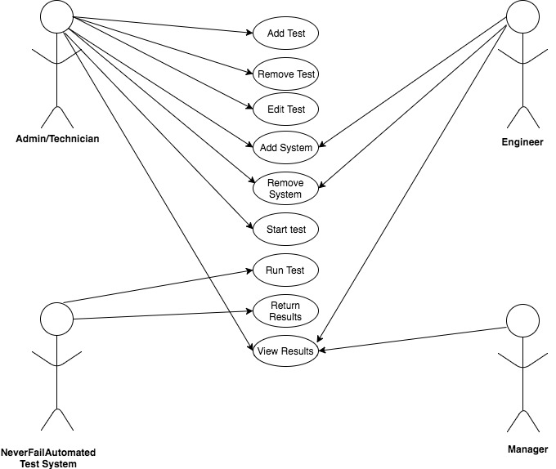
Use Cases

Slide 11
Initial Requirements
SUT requests tests from server
Tests will test major subsystems of a computer such as storage, networking and memory
SUT runs the tests and returns SUCCESS/FAIL
Test results stored in database
A web UI to display test results history
Persistent storage to store tests, results, and test client information
Automate the running of tests on multiple SUTs

Slide 12
Technologies and Tools
Python for writing tests to be implemented
PHP to serve as Command and Control for the web interface:
MYSQL to build the database where tests will be recorded
Java to manage the interaction between the system and the client
HTML & Bootstrap for the Web Front-End
JavaScript plugins such as JQuery for DataTables

Slide 13
Approach
Test-driven development
All test cases will be written before the component the test is intended for is written.
This methodology encourages a complete understanding of the inner workings of the NeverFail system, including corner cases.
After the test case is written, write the code, run the tests, refactor the code and repeat

Slide 14
DEMO

Slide 15
Q&A

